Slide 1
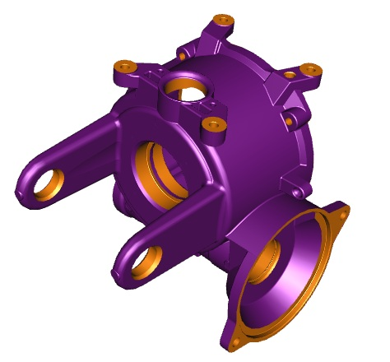
Composite VSS CEPS Housing
Last updated: February 23rd, 2016
Description
A low mass plastic CEPS housing to replace aluminum housings
Deliverables
Development of material, geometry and processing
Evaluate prototype performance and durability
Timing
01 June 2015 – Start of project
Oct 2015 – 1st task closed
February / March 2016 – 1st 4530 prototypes expected
November 2017 – End of project
Team Members/Customers
Team: Michał Olszówka, Zdzisław Sobolewski, Jacek Wyjadłowski, Marcin Komorowski, Silesian University of Technology
Customers: Pursuits Team

Slide 2
Composite VSS CEPS Housing
Last updated: February 23rd, 2016
Status Update:
First task is done (choose of CEPS system)
Ordering stations for validation of VSS
CW7 received of first VSS system DV1
Assembly of Haitec system
Prototype material selection (already ordered waiting for delivery)
Material evaluation
Preparation for first 4530 prototypes casting
Functional testing
Durability testing
Order of VSS housings
Challenges:
Tuning dimensions to tolerance
Functional measurement plan
Thermal stability of parts
Creep stability of parts
Cost savings to Aluminum
Elimination of snap rings
Next Actions:
Validation on VSS
Stress measurements on housings
FEA analysis of housings
Evaluation on prototypes (4530)

